Slide 1
Privacy as we (don’t) know it
An eye-opening experience presented by
Michael Almquist

Slide 2
What is Privacy?
The state of being free from being observed or disturbed by other people.

Slide 3
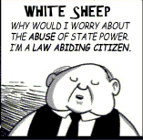
Food for thought
If you aren’t doing anything wrong, what do you have to hide?

Slide 4
Survey responses
35 Total Responses

Slide 5
Survey responses
35 Total Responses

Slide 6
William’s wisdom
“When you’re a doctor seeing a patient you’re there by permission: the two of you have an agreement”
“you’re telling someone something, rather than asking; you’re giving advice—orders really.”
“you can explore this body of mine, and you can ask me any damn thing you want, because that’s who you are, a doctor, and that’s who I am, a patient.”

Slide 7
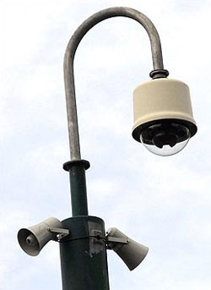
1984 telescreens
Television-like devices
Recorded video & sound
Projected voice

Slide 8
WHAT ABOUT OUR constitutional RIGHTS?
We have none!
Privacy shouldn’t have to be granted through a right

Slide 9
Works Cited
Almquist, Mike. “Anonymous Surveillance Survey” Survey. 10 May 2011. Spokane Falls Community College Student Union Building Lounge.
Bartholomae, David and Anthony Petroska. Ways of Reading Words and Images. Boston: Bedford/St Martins. 2003. Print.
Orwell, George. 1984. New York, NY: Signet Classic, 1977. Print.

